Slide 1
SQL Injection
Lecture -3
CPSC 4670

Slide 2
Topics
What are injection attacks?
How SQL Injection Works
Exploiting SQL Injection Bugs
Mitigating SQL Injection
Other Injection Attacks

Slide 3
Injection
Injection attacks trick an application into including unintended commands in the data send to an interpreter.
Interpreters
Interpret strings as commands.
Ex: SQL, shell (cmd.exe, bash), LDAP, XPath
Key Idea
Input data from the application is executed as code by the interpreter.

Slide 4
SQL Injection
App sends form to user.
Attacker submits form with SQL exploit data.
Application builds string with exploit data.
Application sends SQL query to DB.
DB executes query, including exploit, sends data back to application.
Application returns data to user.
Attacker
Form
User
Pass
‘ or 1=1--
Firewall
DB Server
Web Server

Slide 5
SQL Injection in PHP
$link = mysql_connect($DB_HOST, $DB_USERNAME, $DB_PASSWORD) or die ("Couldn't connect: " . mysql_error());
mysql_select_db($DB_DATABASE);
$query = "select count(*) from users where username = '$username' and password = '$password‘ ";
$result = mysql_query($query);

Slide 6
SQL Injection Attack #1
Unauthorized Access Attempt:
password = ’ or 1=1 --
SQL statement becomes:
select count(*) from users where username = ‘user’ and password = ‘’ or 1=1 --
Checks if password is empty OR 1=1, which is always true, permitting access.

Slide 7
SQL Injection Attack #2
Database Modification Attack:
password = foo’; delete from table users
where username like ‘%
DB executes two SQL statements:
select count(*) from users where username = ‘user’ and password = ‘foo’
delete from table users where username like ‘%’
Notes:
Principle of Least Privilege likely violated as web server user needs privileges to do all operators permitted on users, including deleting them.

Slide 8
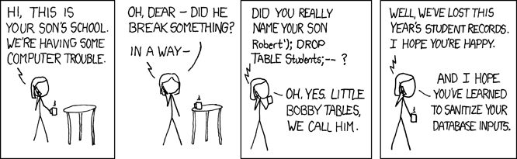
Exploits of a Mom

Slide 9
Injecting into SELECT
Most common SQL entry point.
SELECT columns
FROM table
WHERE expression
ORDER BY expression
Places where user input is inserted:
WHERE expression
ORDER BY expression
Table or column names

Slide 10
Injecting into INSERT
Creates a new data row in a table.
INSERT INTO table (col1, col2, ...)
VALUES (val1, val2, ...)
Requirements
Number of values must match # columns.
Types of values must match column types.
Technique: add values until no error.
foo’)--
foo’, 1)--
foo’, 1, 1)--

Slide 11
Injecting into UPDATE
Modifies one or more rows of data.
UPDATE table
SET col1=val1, col2=val2, ...
WHERE expression
Places where input is inserted
SET clause
WHERE clause
Be careful with WHERE clause
’ OR 1=1 will change all rows

Slide 12
Inference Attacks
Problem: What if app doesn’t print data?
Injection can produce detectable behavior
Successful or failed web page.
Noticeable time delay or absence of delay.
Identify an exploitable URL
http://site/blog?message=5 AND 1=1
http://site/blog?message=5 AND 1=2

Slide 13
More Examples (1)
Application authentication bypass using SQL injection.
Suppose a web form takes userID and password as input.
The application receives a user ID and a password and authenticates the user by checking the existence of the user in the USER table and matching the data in the PWD column.
Assume that the application is not validating what the user types into these two fields and the SQL statement is created by string concatenation.

Slide 14
More Example (2)
The following code could be an example of such bad practice:
sqlString = “select USERID from USER where USERID = `” & userId & “` and PWD = `” & pwd & “`”
result = GetQueryResult(sqlString)
If(result = “”) then
userHasBeenAuthenticated = False
Else
userHasBeenAuthenticated = True
End If

Slide 15
More Example (3)
User ID: ` OR ``=`
Password: `OR ``=`
In this case the sqlString used to create the result set would be as follows:
select USERID from USER where USERID = ``OR``=``and PWD = `` OR``=``
select USERID from USER where USERID = ``OR``=``and PWD = `` OR``=``
TRUE TRUE
Which would certainly set the userHasBenAuthenticated variable to true.

Slide 16
More Example (4)
User ID: ` OR ``=`` --
Password: abc
Because anything after the -- will be ignore, the injection will work even without any specific injection into the password predicate.

Slide 17
More Example (5)
User ID: ` ; DROP TABLE USER ; --
Password: `OR ``=`
select USERID from USER where USERID = `` ; DROP TABLE USER ; -- ` and PWD = ``OR ``=``
I will not try to get any information, I just wan to bring the application down.

Slide 18
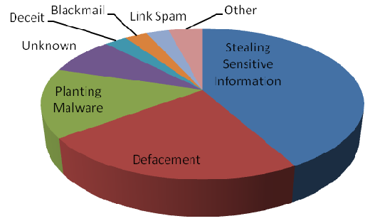
Impact of SQL Injection
Leakage of sensitive information.
Reputation decline.
Modification of sensitive information.
Loss of control of db server.
Data loss.
Denial of service.

Slide 19
Mitigating SQL Injection
Ineffective Mitigations
Blacklists
Stored Procedures
Partially Effective Mitigations
Whitelists
Prepared Queries

Slide 20
Blacklists
Filter out or Sanitize known bad SQL meta-characters, such as single quotes.
Problems:
Numeric parameters don’t use quotes.
URL escaped metacharacters.
Unicode encoded metacharacters.
Did you miss any metacharacters?
Though it's easy to point out some dangerous characters, it's harder to point to all of them.

Slide 21
Bypassing Filters
Different case
SeLecT instead of SELECT or select
Bypass keyword removal filters
SELSELECTECT
URL-encoding
%53%45%4C%45%43%54
SQL comments
SELECT/*foo*/num/*foo*/FROM/**/cc
SEL/*foo*/ECT
String Building
‘us’||’er’
chr(117)||chr(115)||chr(101)||chr(114)

Slide 22
Stored Procedures
Stored Procedures build strings too:
CREATE PROCEDURE dbo.doQuery(@id nchar(128))
AS
DECLARE @query nchar(256)
SELECT @query = ‘SELECT cc FROM cust WHERE id=‘’’ + @id + ‘’’’
EXEC @query
RETURN
it's always possible to write a stored procedure that itself constructs a query dynamically: this provides no protection against SQL Injection. It's only proper binding with prepare/execute or direct SQL statements with bound variables that provide protection.

Slide 23
Whitelist
Reject input that doesn’t match your list of safe characters to accept.
Identify what is good, not what is bad.
Reject input instead of attempting to repair.
Still have to deal with single quotes when required, such as in names.

Slide 24
Other Injection Types
Shell injection.
Scripting language injection.
File inclusion.
XML injection.
XPath injection.
LDAP injection.
SMTP injection.

Slide 25
SQL injection Conclusion
SQL injection is technique for exploiting applications that use relational databases as their back end.
Applications compose SQL statements and send to database.
SQL injection use the fact that many of these applications concatenate the fixed part of SQL statement with user-supplied data that forms WHERE predicates or additional sub-queries.

Slide 26
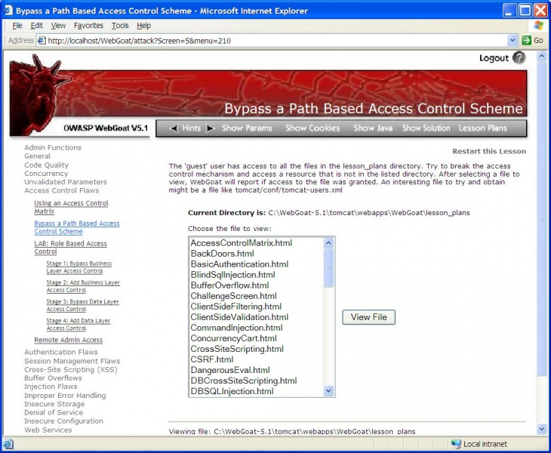
Assignment: Due on March 10,2025
Visit the website for information about webGoat: http://www.irongeek.com/i.php?page=videos/webgoat-sql-injection
Read WebGoad User and Install Guide http://www.owasp.org/index.php/Category:OWASP_WebGoat_Project
Install WebGoat and play with SQL injection.

